Slide 1

Analyses of genome data
Maria Izabel Cavassim Alves

Slide 2
Learning goals
At the end of this workshop, you will be able to:
Describe what a variant calling file (VCF) format is and how to manage those files.
Conduct quality assessment of a VCF.
Learn about population structure and how to compute it with PLINK.
Learn about linkage disequilibrium and how to compute it with PLINK.
Learn about basic association testing and genome wide association studies (GWAS).
Learn about copy number variants (CNVs) and how to test for common CNVs across individuals.
Discuss original literature within the subjects.

Slide 3
Github with instructions
All assignments will be posted on this github page:
https://github.com/izabelcavassim/Analyses_of_genome_data
Under the “Assignments” folder
Students are required to send an e-mail to me with their assignments:
izabelcavassim@gmail.com
If you have any questions, doubts, trouble with any of the analyses please do not hesitate to contact me!

Slide 4
Day 1
Background lecture (45 minutes)
What is a VCF?
What is QC, and why is it so important?
Break (15 minutes)
Hands on exercise (1 hour)
VCF Data management (read, recode, reorder, merge, subset, compress data)
QC assessment
Break (15 minutes)
Paper discussion on quality control assessment (30 minutes)
Assignment explanation (15 minutes)

Slide 5
Day 2
Background lecture (45 minutes)
What is population structure?
What is linkage disequilibrium?
How does population structure and LD affect association mapping?
Break (15 minutes)
Hands on exercise (1 hour)
Population stratification detection
LD estimation
Break (15 minutes)
Paper discussion on genome wide association studies
Assignment explanation (15 minutes)

Slide 6
Day 3
Peer review of previous assignment (15 minutes)
Background lecture (45 minutes)
What is association testing and GWAS?
What is a Manhattan plot and a Q-Q plot?
What is a copy number variant?
Break (15 minutes)
Hands-on exercise (1 hour and 30 minutes)
Basic association testing
GWAS accounting for population structure
CNV detection
Break (15 minutes)
Assignment explanation (15 minutes)

Slide 7
Analyses of genome data Day 1 Tuesday, 30 November 2021
Maria Izabel Cavassim Alves

Slide 8
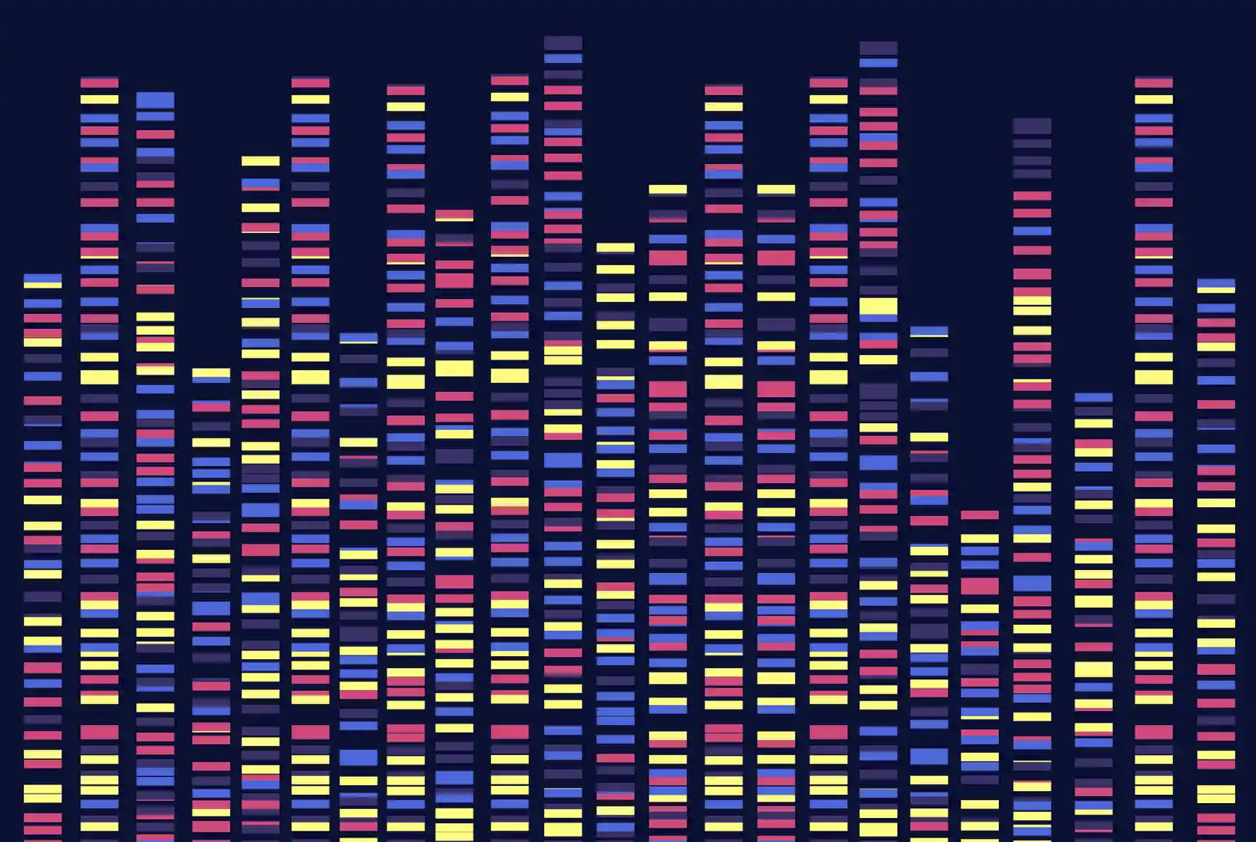
Day 1
Analyses of genome data:
What is a VCF file?
Why do we care about analyzing
Genomes?

Slide 9
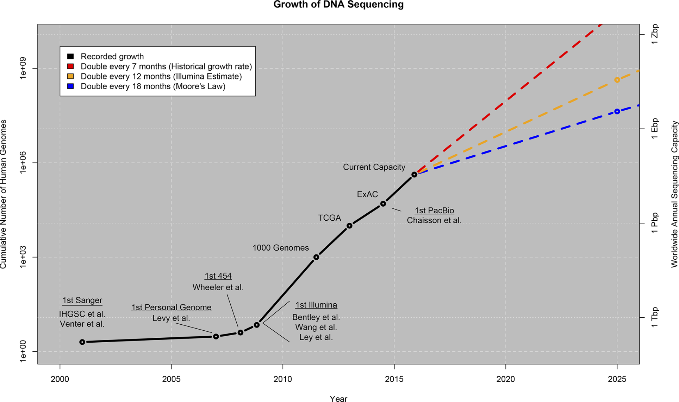
Genome data beyond human sequences is growing!
Stephens et al., 2015

Slide 10
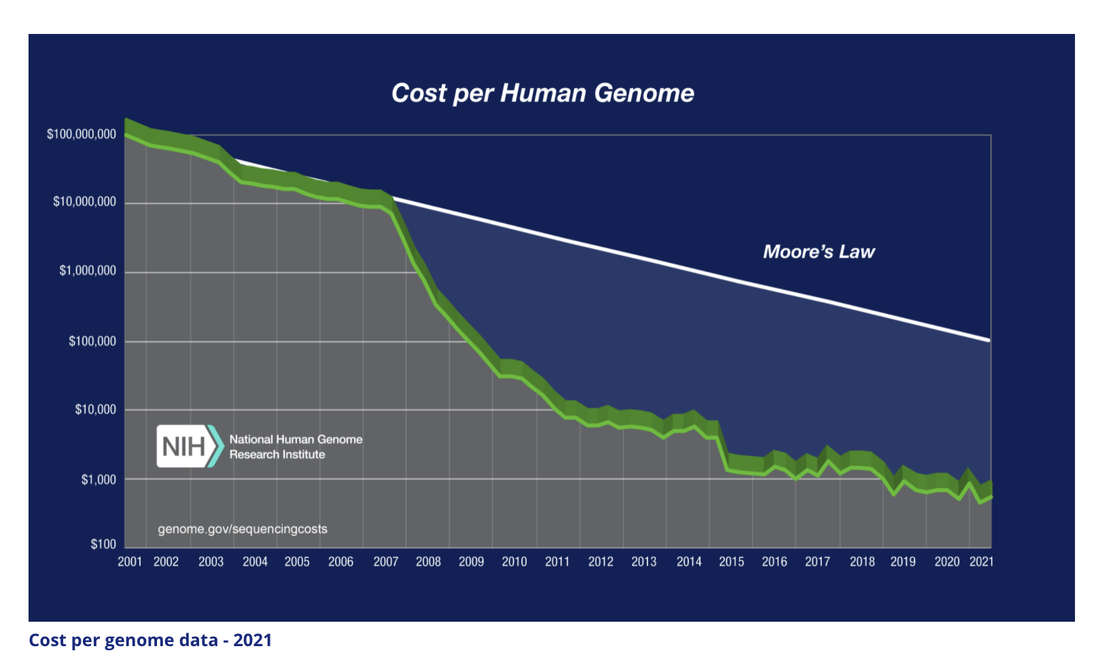
Sequencing is becoming cheaper and cheaper!

Slide 11
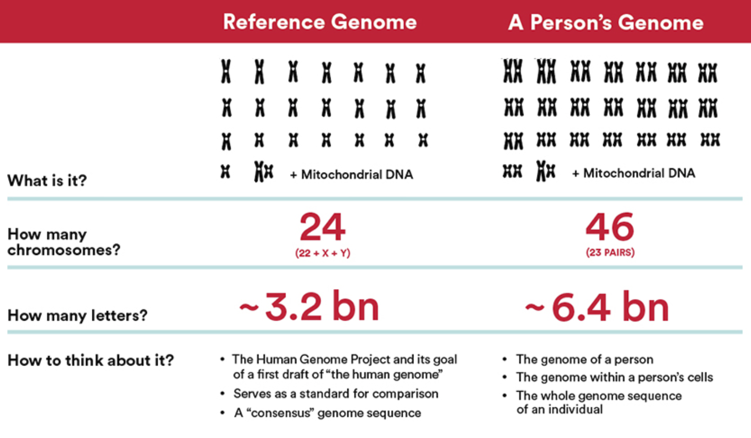
Genome (Human)

Slide 12
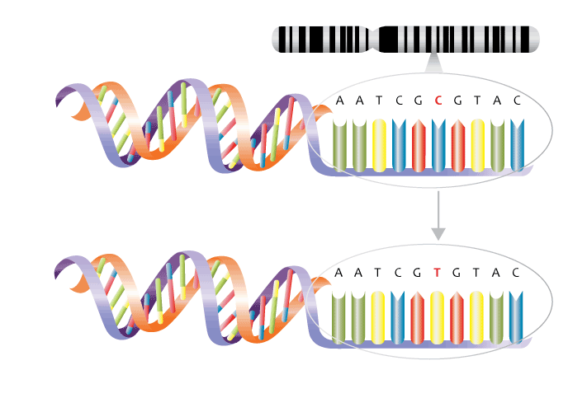
What can we do with a reference genome?
We can identify mutations, specifically we can identify Single Nucleotide Polymorphisms!!!
Reference genome
One single mutation
Your genome

Slide 13
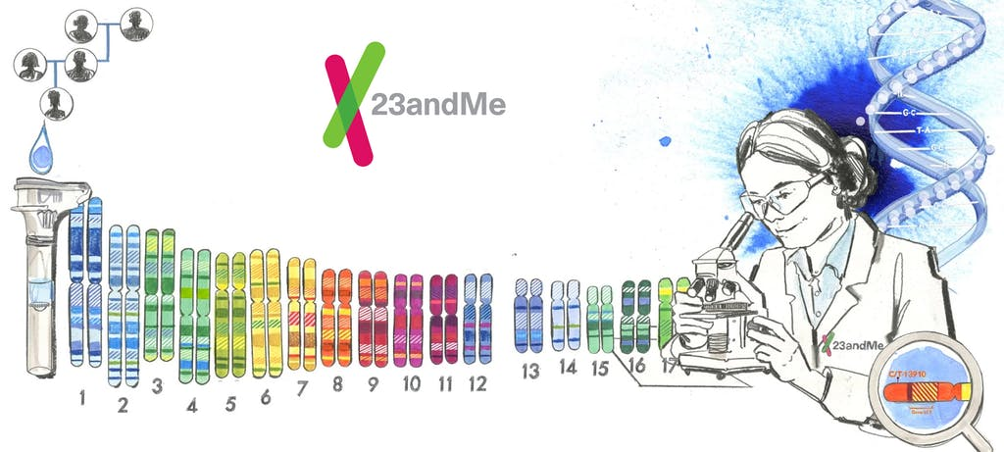
What can we learn from SNPs? A lot!!

Slide 14
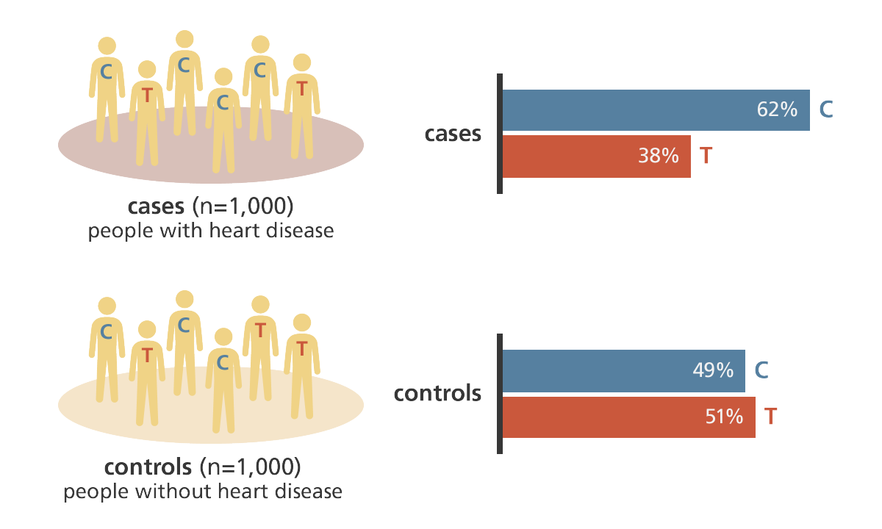
What can we learn from this SNPs? A lot!!
Is that C/T SNP associated with a higher risk for a really nasty disease?

Slide 15
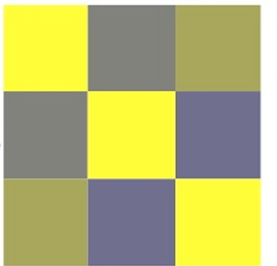
What can we learn from this SNPs? A lot!!
Are there related individuals in the sample?
Cavassim et al., 2020

Slide 16
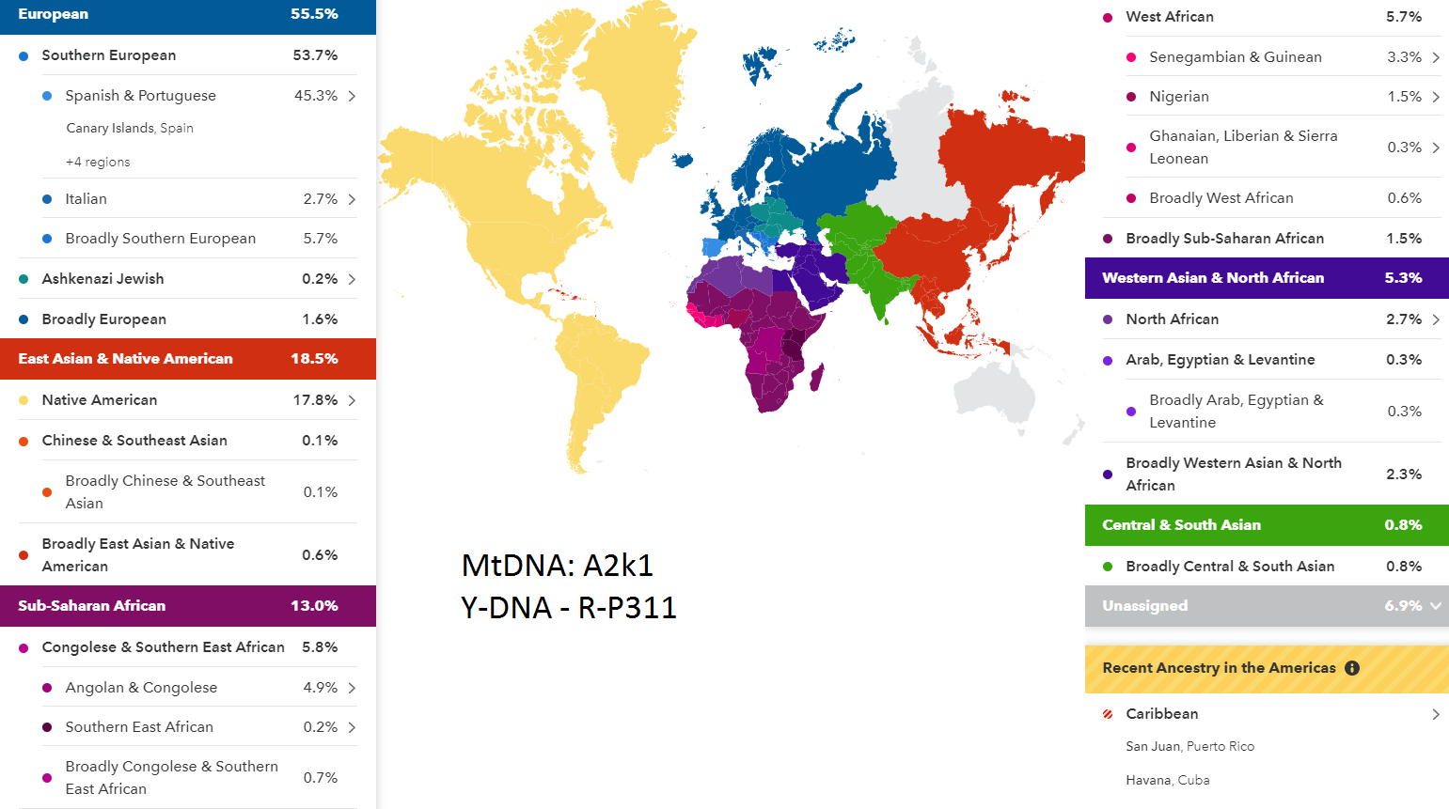
What can we learn from SNPs? A lot!!
What is an individual ancestry?

Slide 17
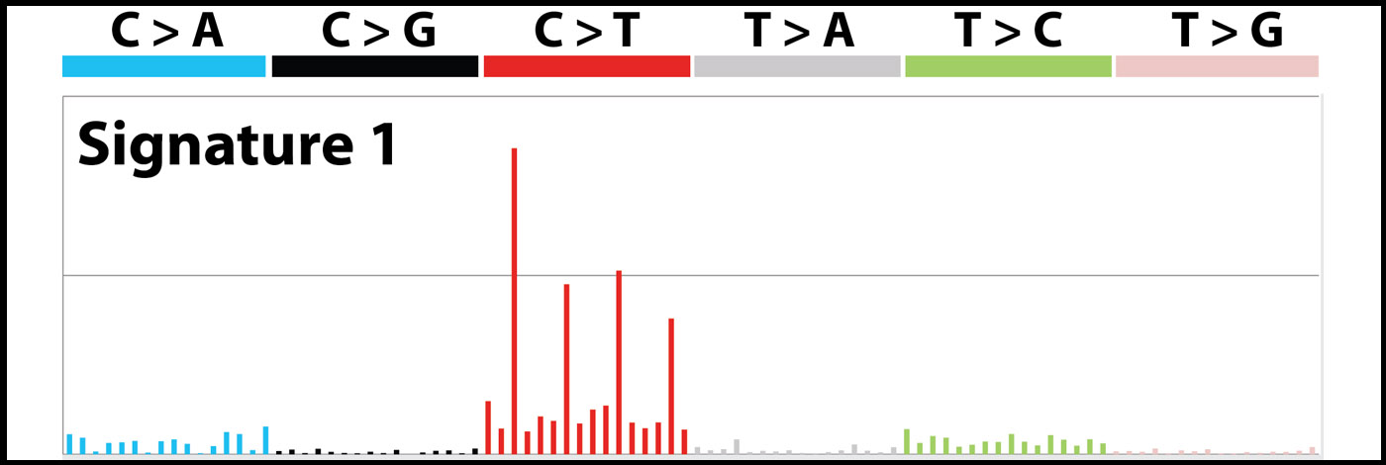
What can we learn from SNPs? A lot!!
What are the mutational patterns in cancer?

Slide 18
What are the first steps one needs to take once the data is generated?

Slide 19

15 minutes break!

Slide 20
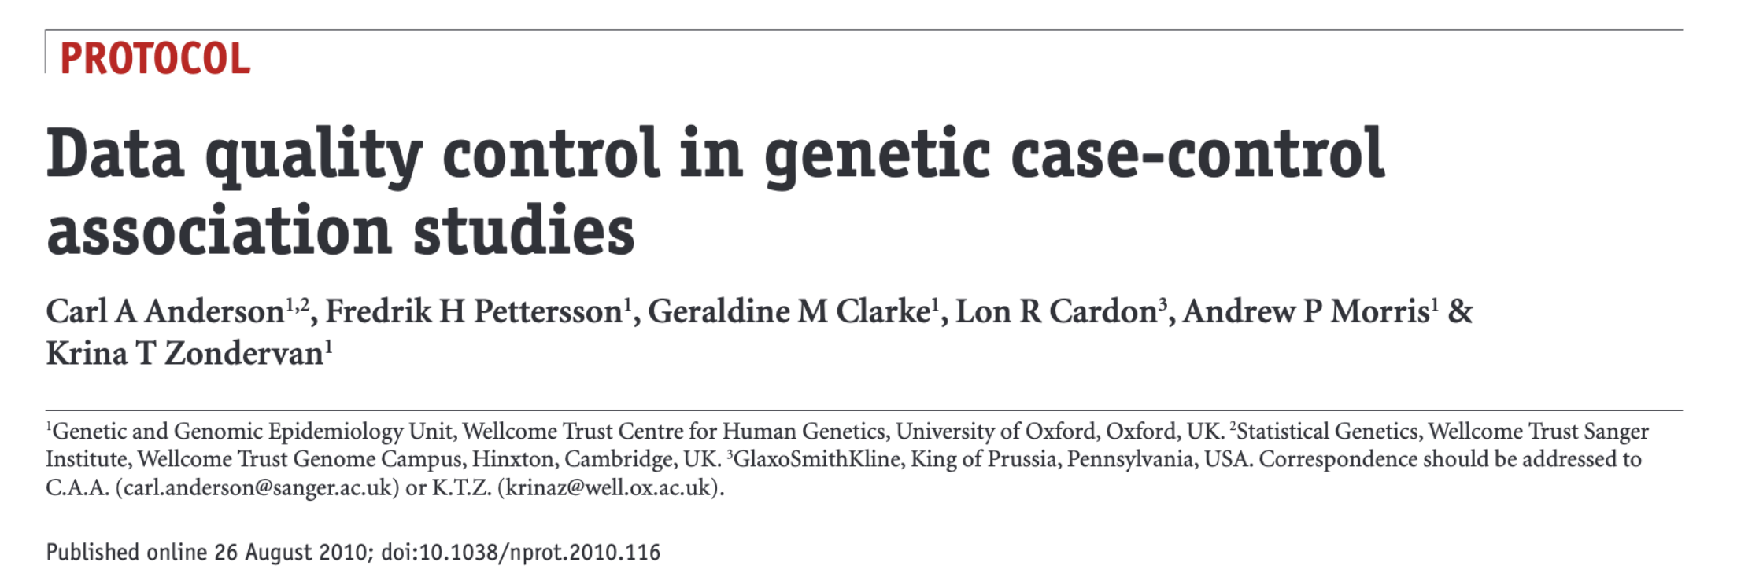
Practical exercise (Assignment 1 - QC)
We will be following the tutorial for Quality Control of genomic data by Anderson et al 2010:

Slide 21
Practical exercise (Assignment 1 - QC)
To get started we need to:
Access the Hoffman cluster
Install Plink on the cluster
Install R and R studio on your machine
Download the R markdown version of the assignment here:
Read the paper while doing the exercise

Slide 22
Installing R and R markdown

Slide 24
Analyses of genome data Day 2 Tuesday, 1 December 2021
Maria Izabel Cavassim Alves

